Slide 1
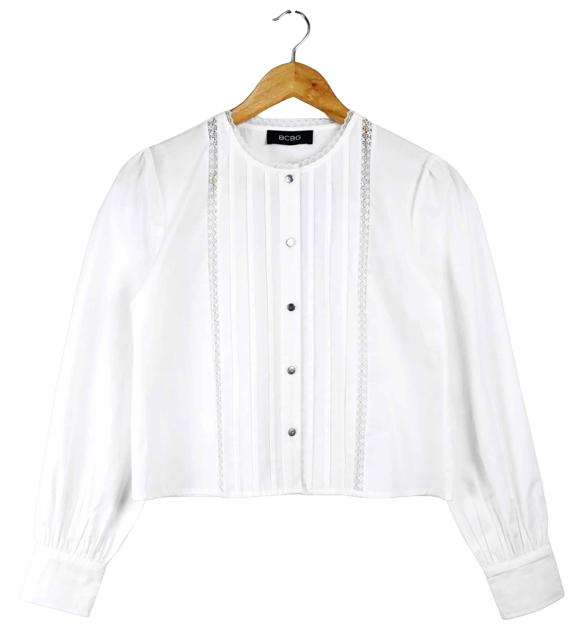
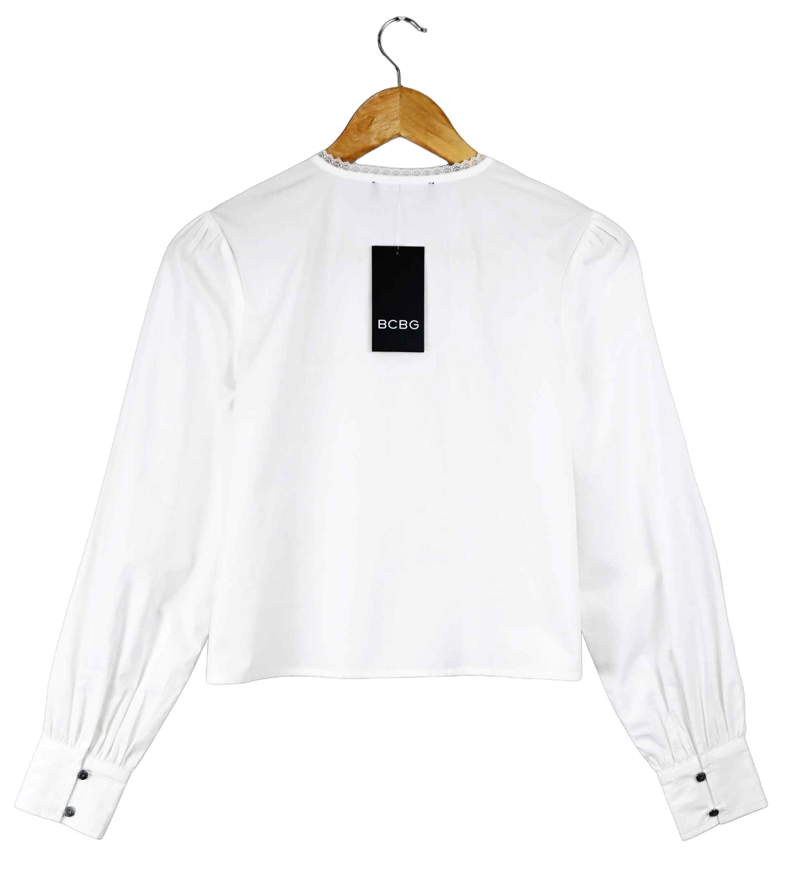
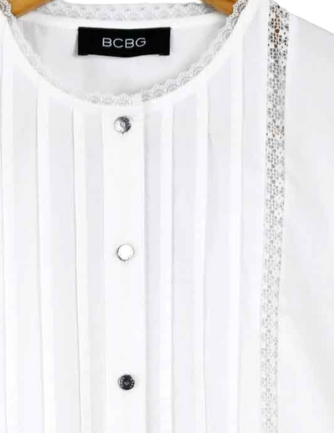
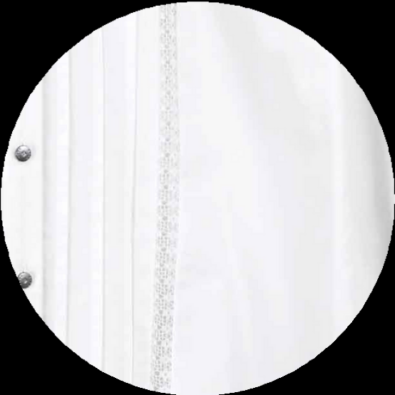
WOMEN PRODUCT
B6BAL53C
100% COTTON
DESIGN DETAIL
FABRIC DETAIL

Slide 2
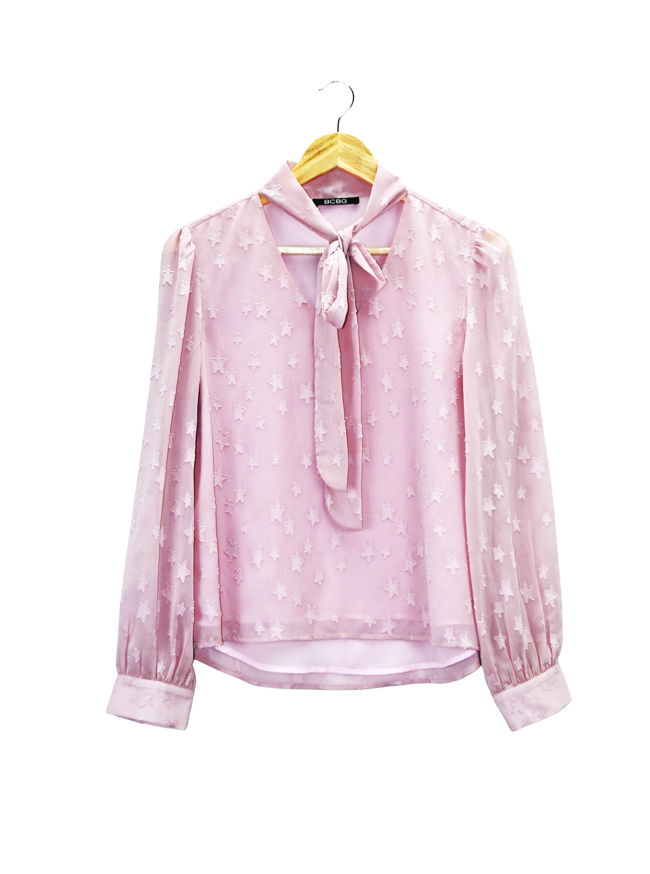
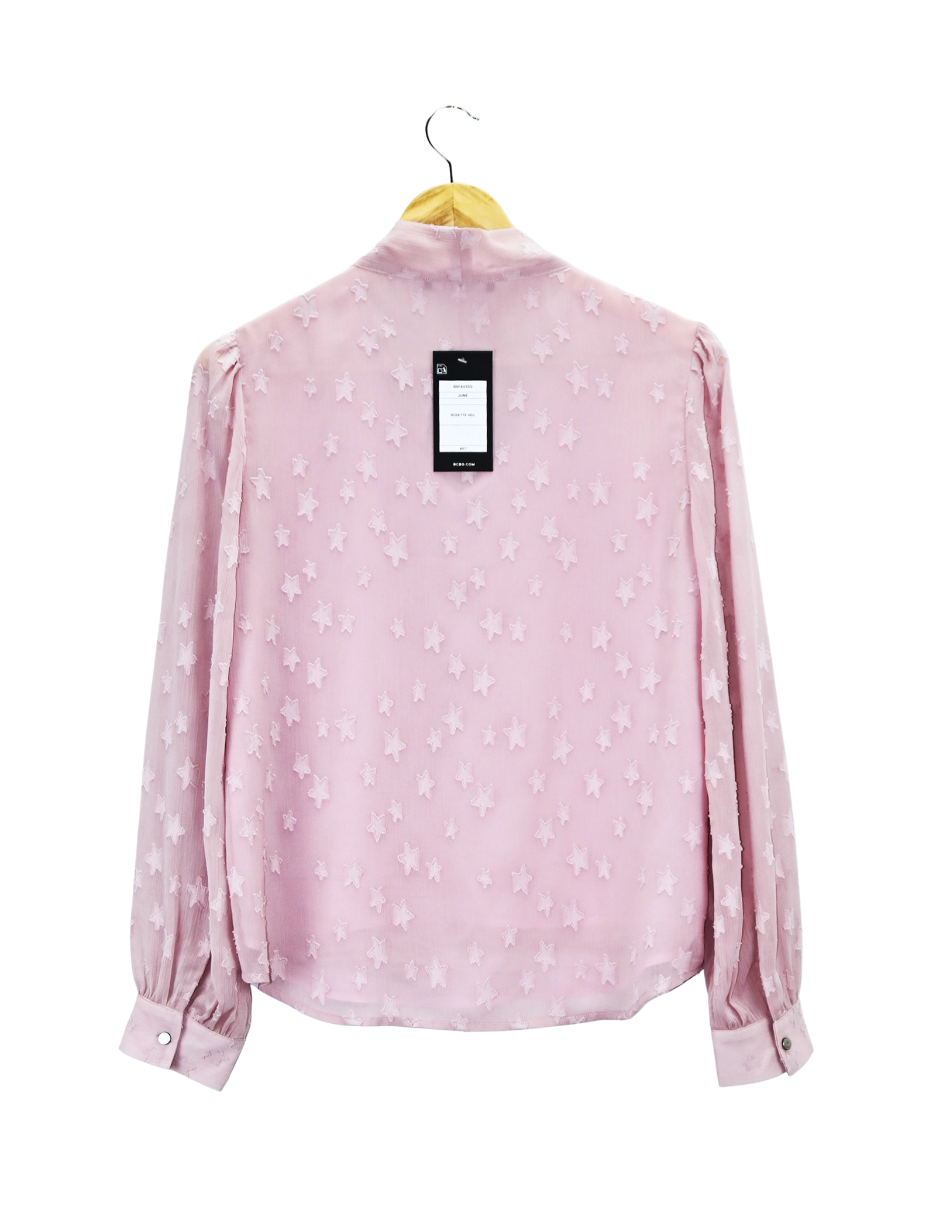
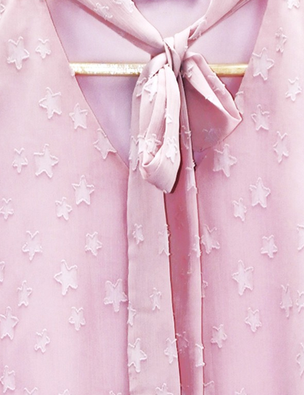
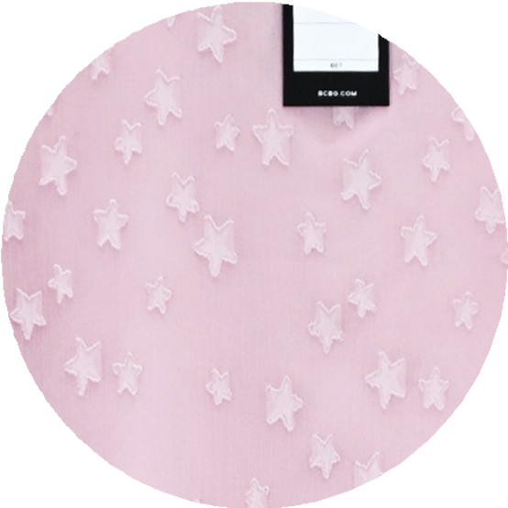
WOMEN PRODUCT
B6FAV55G
100% POLY CHIFFON JACQUARD
DESIGN DETAIL
FABRIC DETAIL

Slide 3
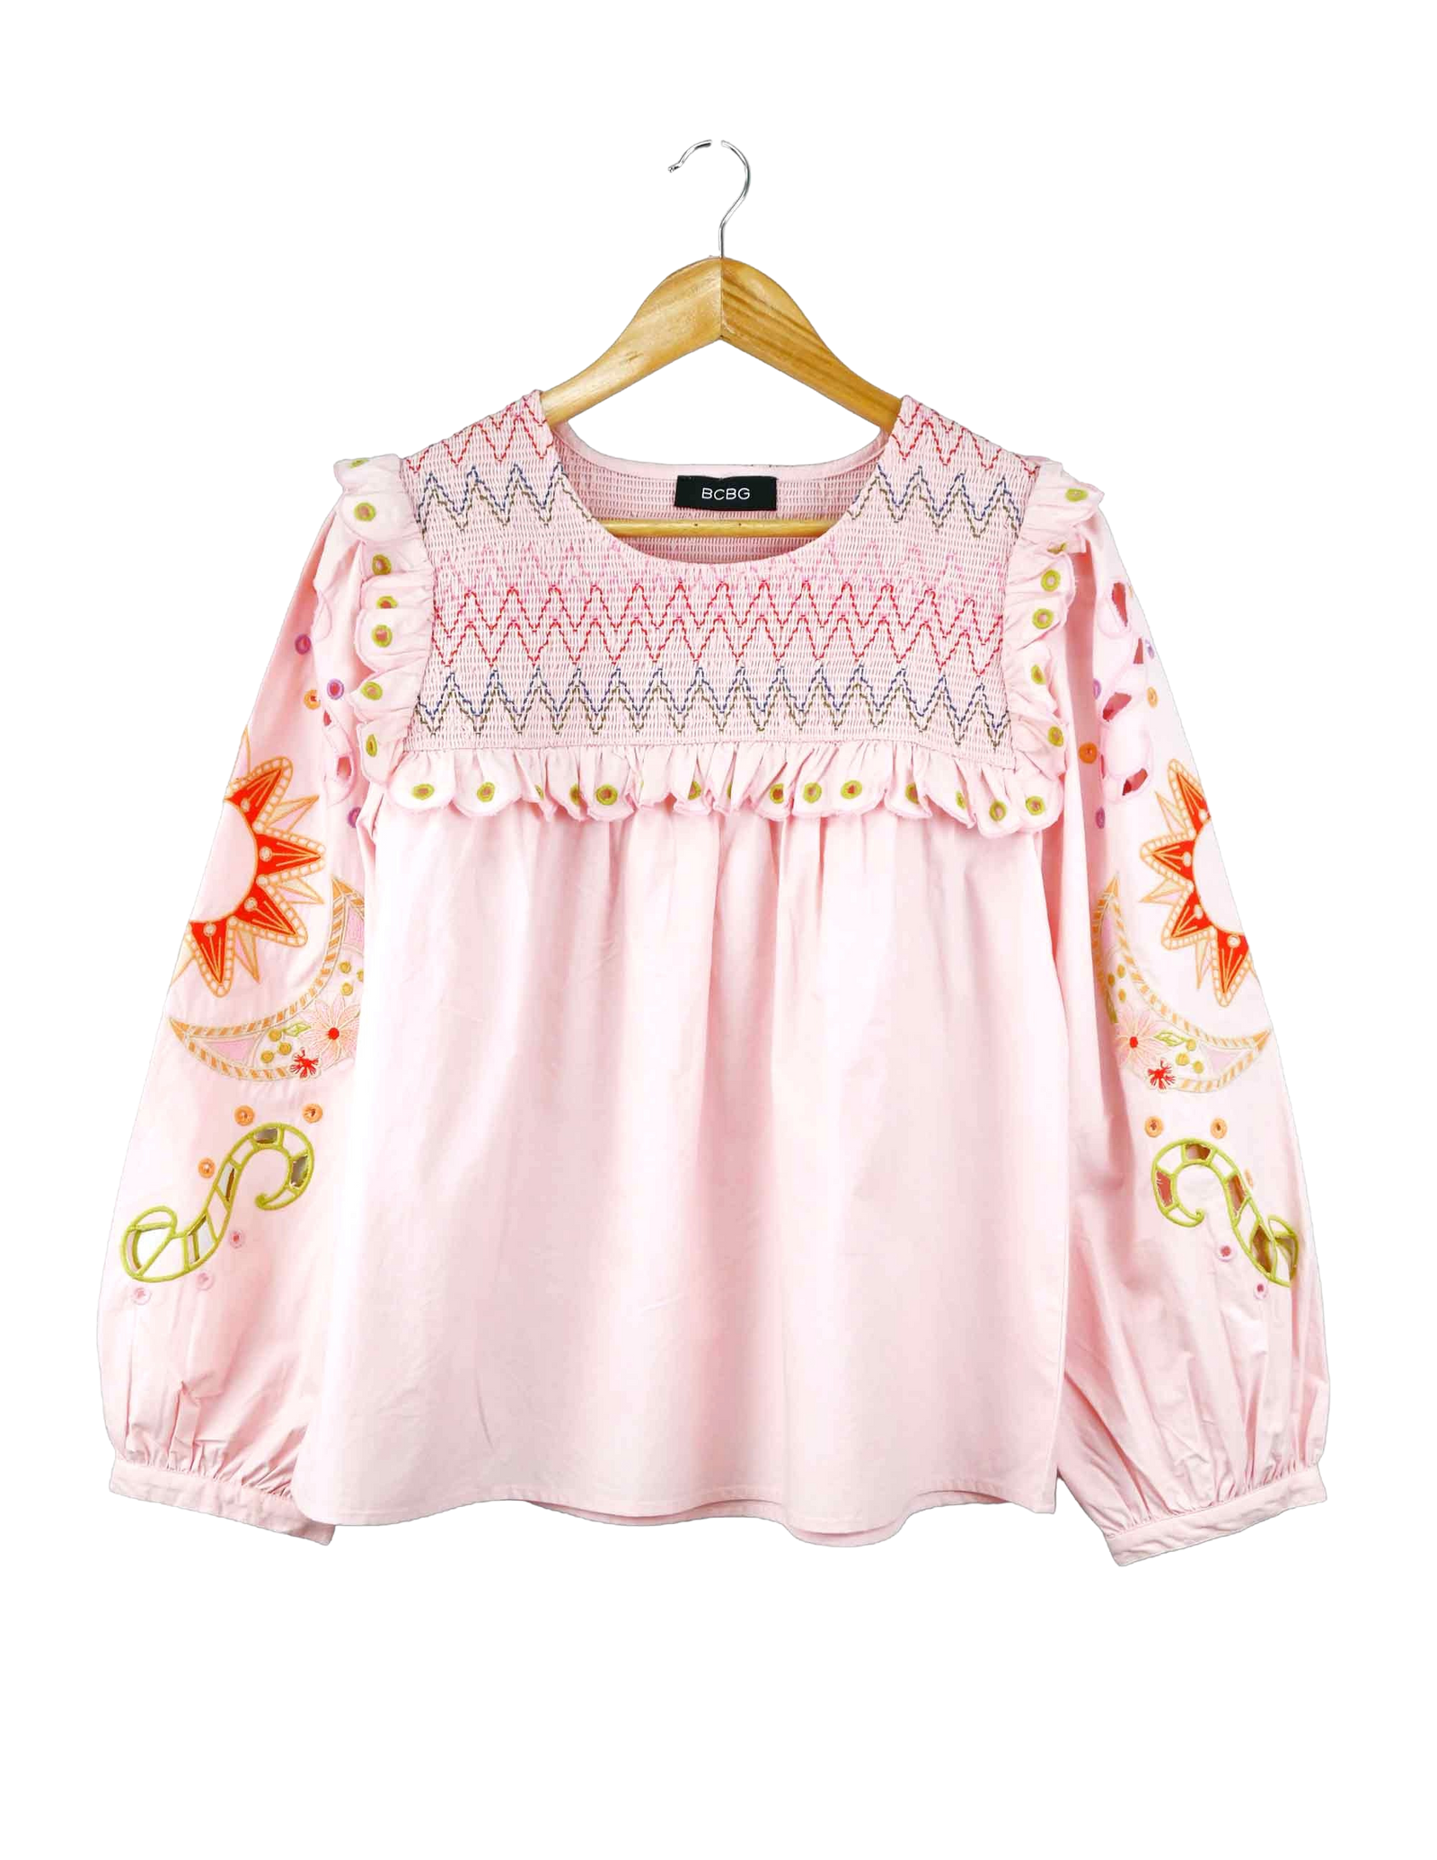
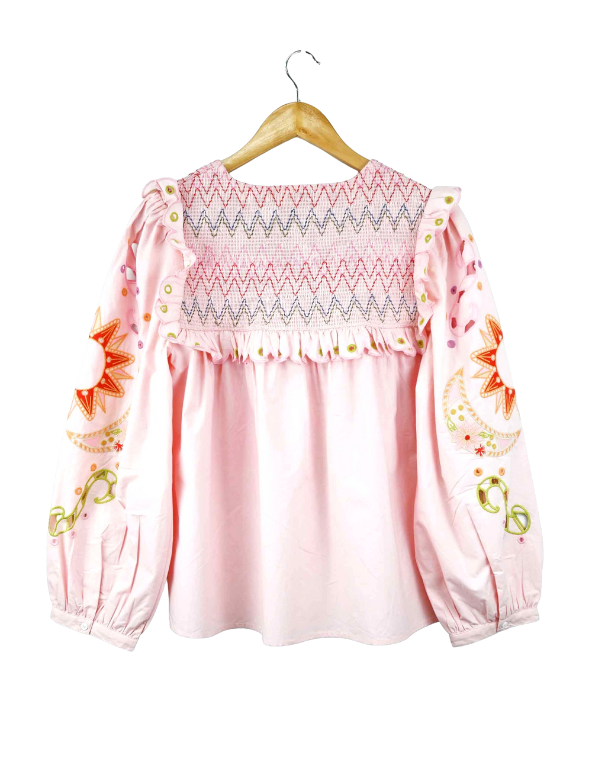
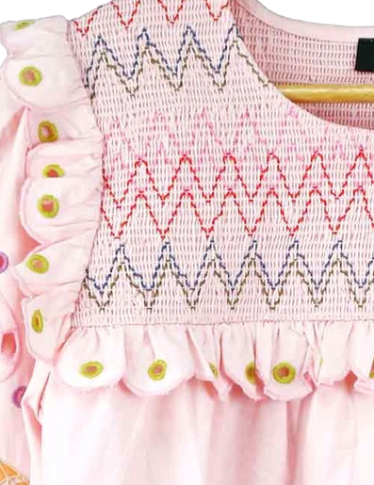
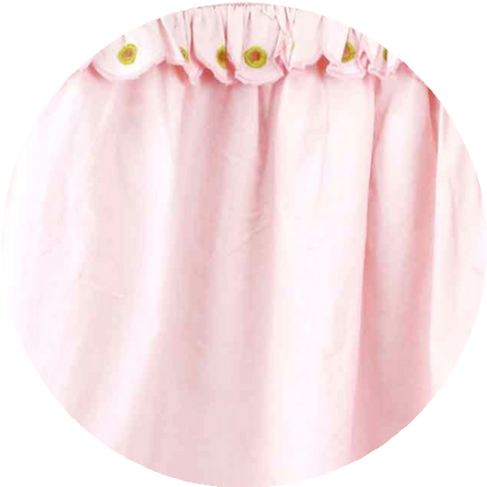
WOMEN PRODUCT
DES-IBS-112
100% COTTON
40s POPLIN
DESIGN DETAIL
FABRIC DETAIL

Slide 4
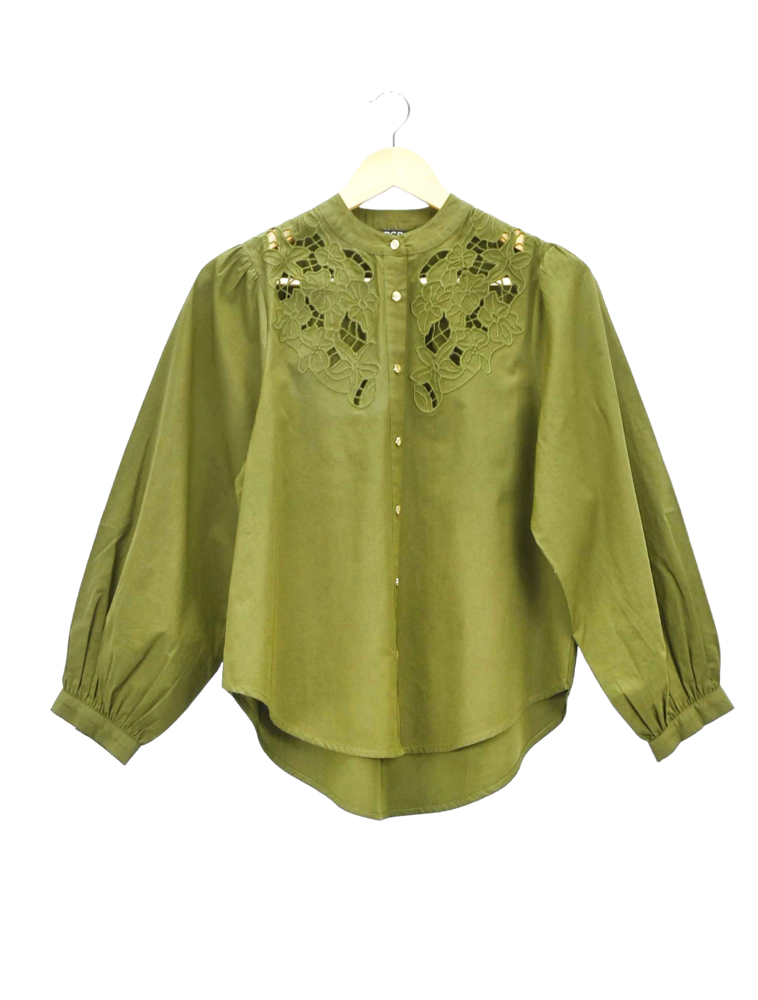
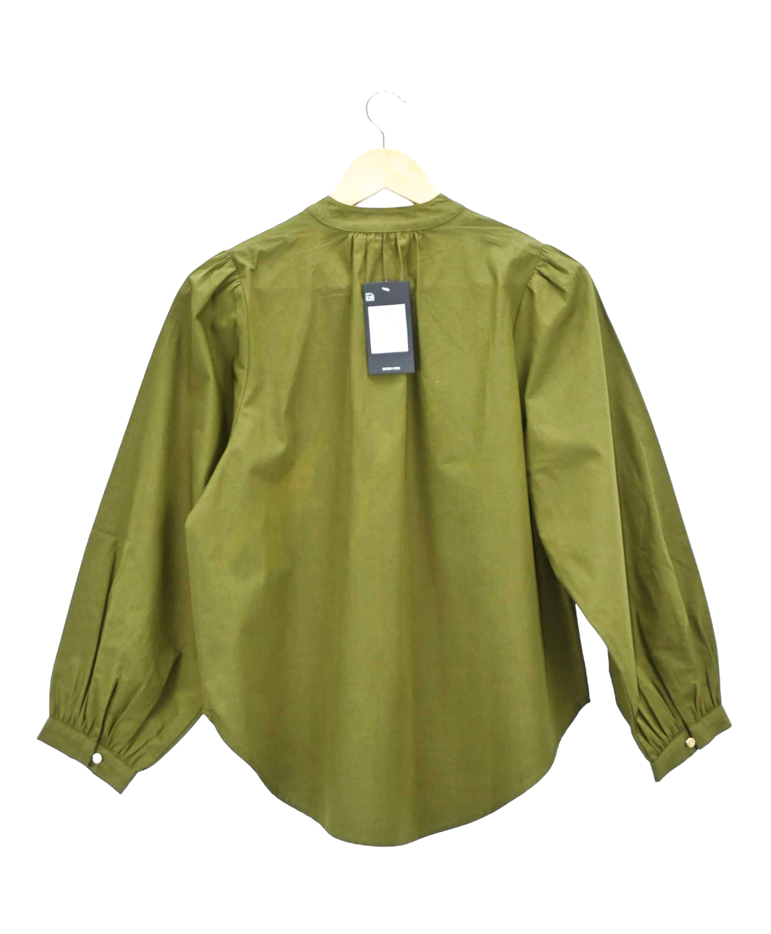
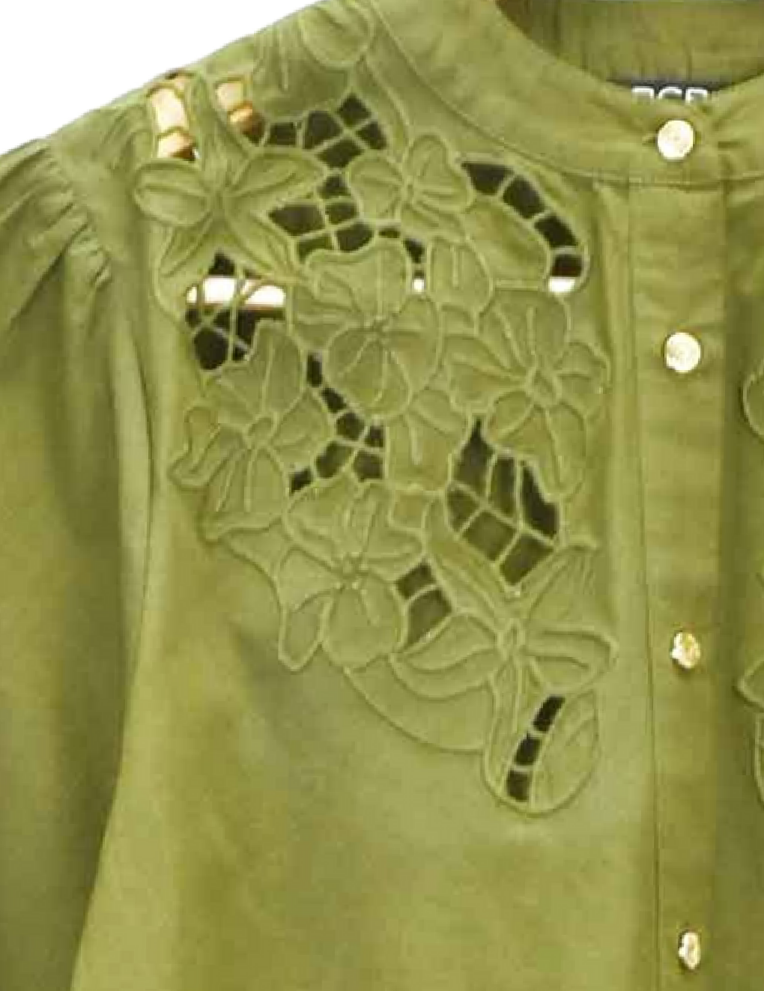
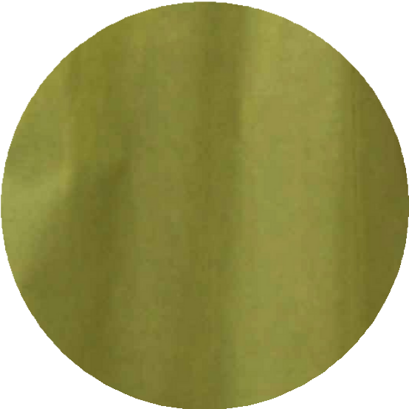
WOMEN PRODUCT
B6CAL53D
100% COTTON
DESIGN DETAIL
FABRIC DETAIL

Slide 5
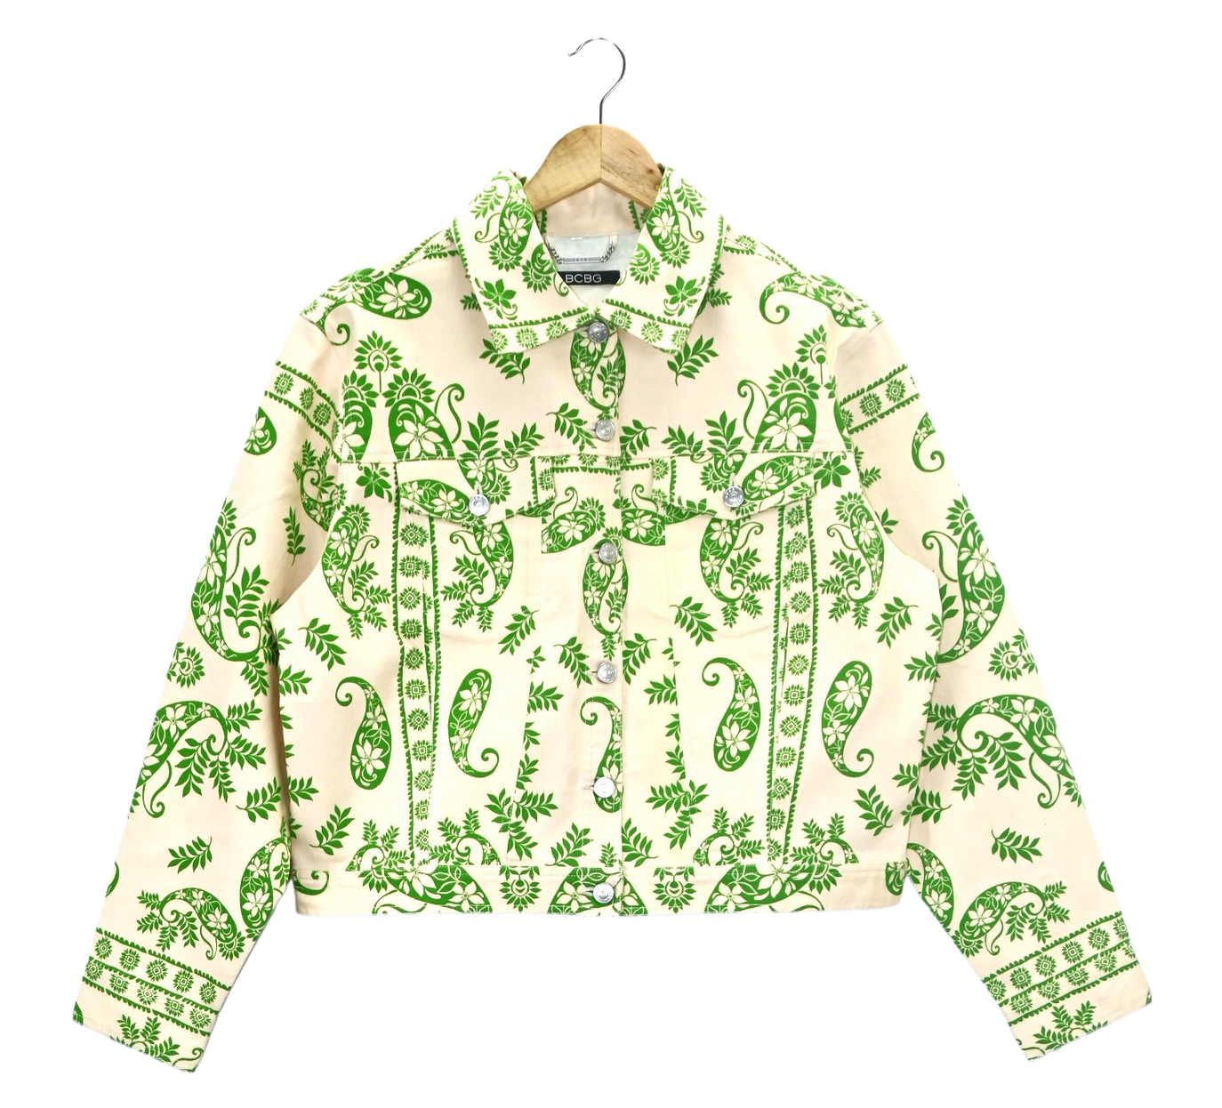
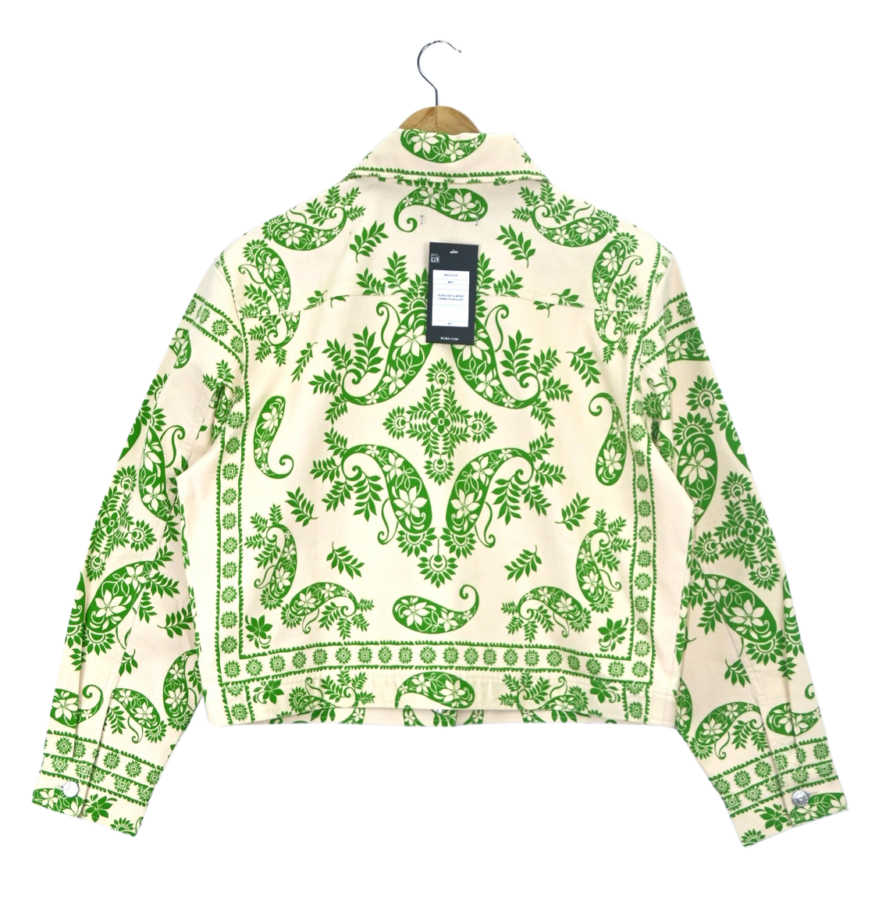
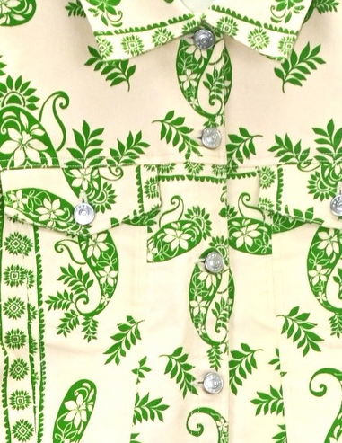
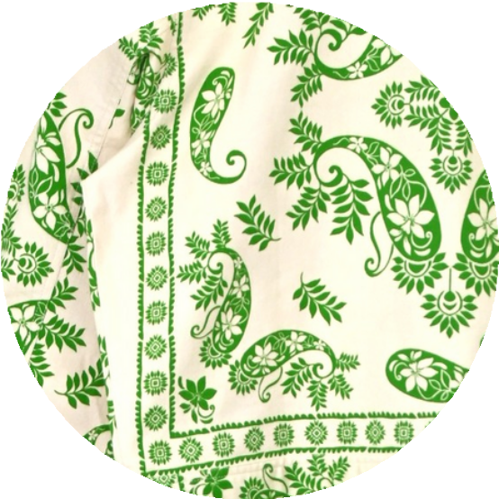
WOMEN PRODUCT
B6DCA191
82% COTTON
17% POLYESTER
1% ELASTANE
DESIGN DETAIL
FABRIC DETAIL

Slide 6
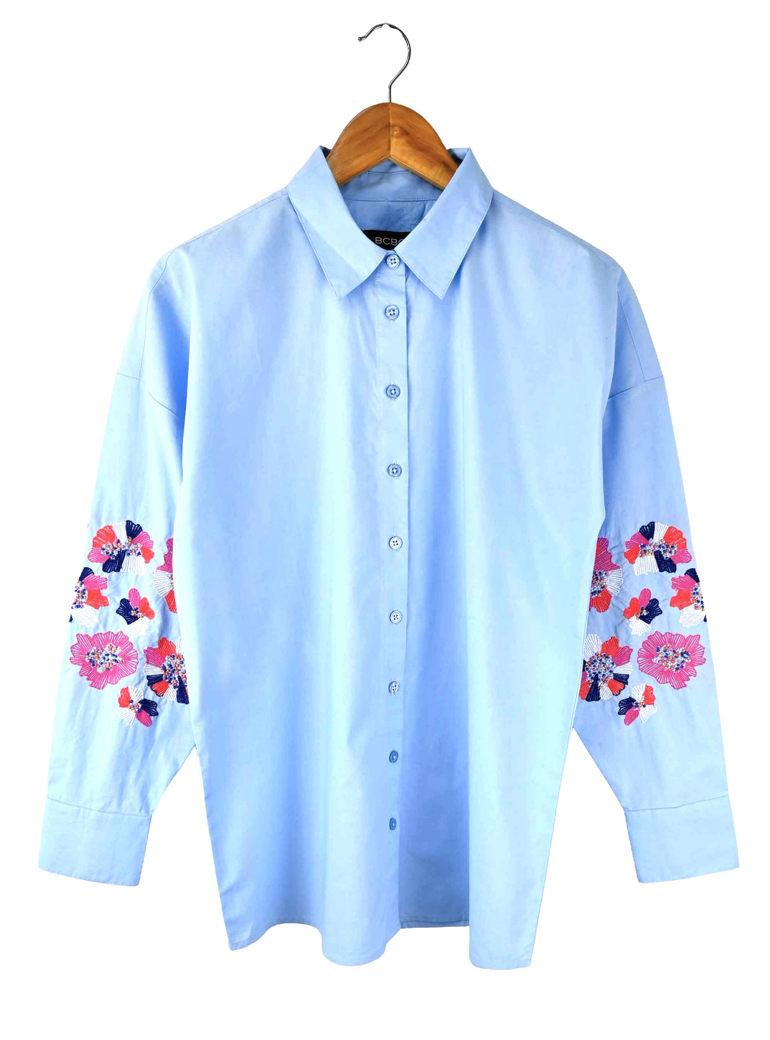
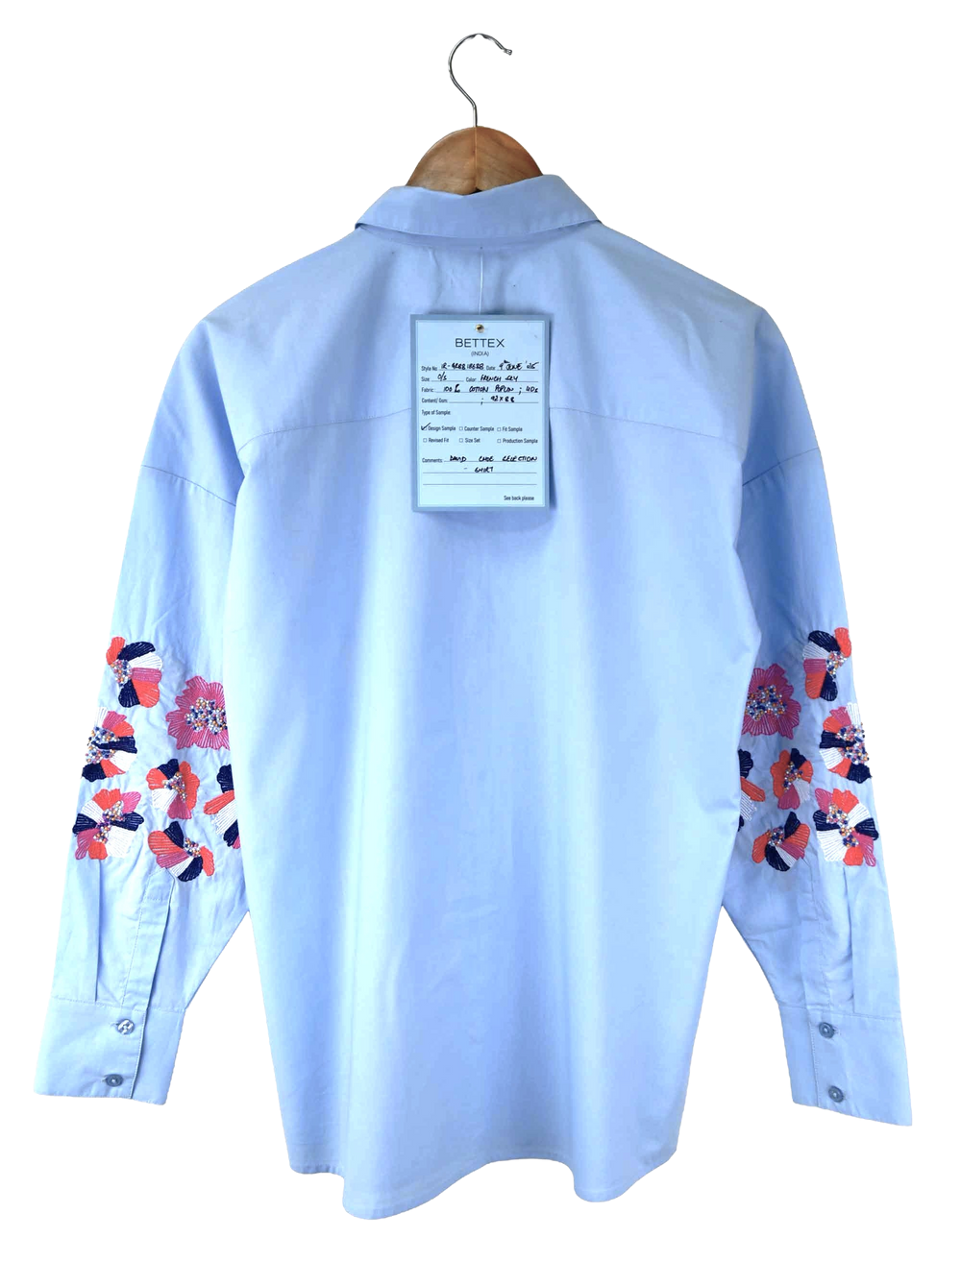
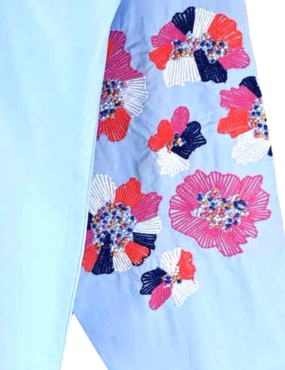
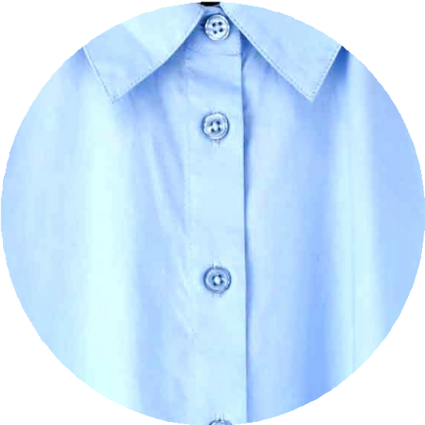
WOMEN PRODUCT
IR-GR8818638
100% COTTON
DESIGN DETAIL
FABRIC DETAIL

Slide 7
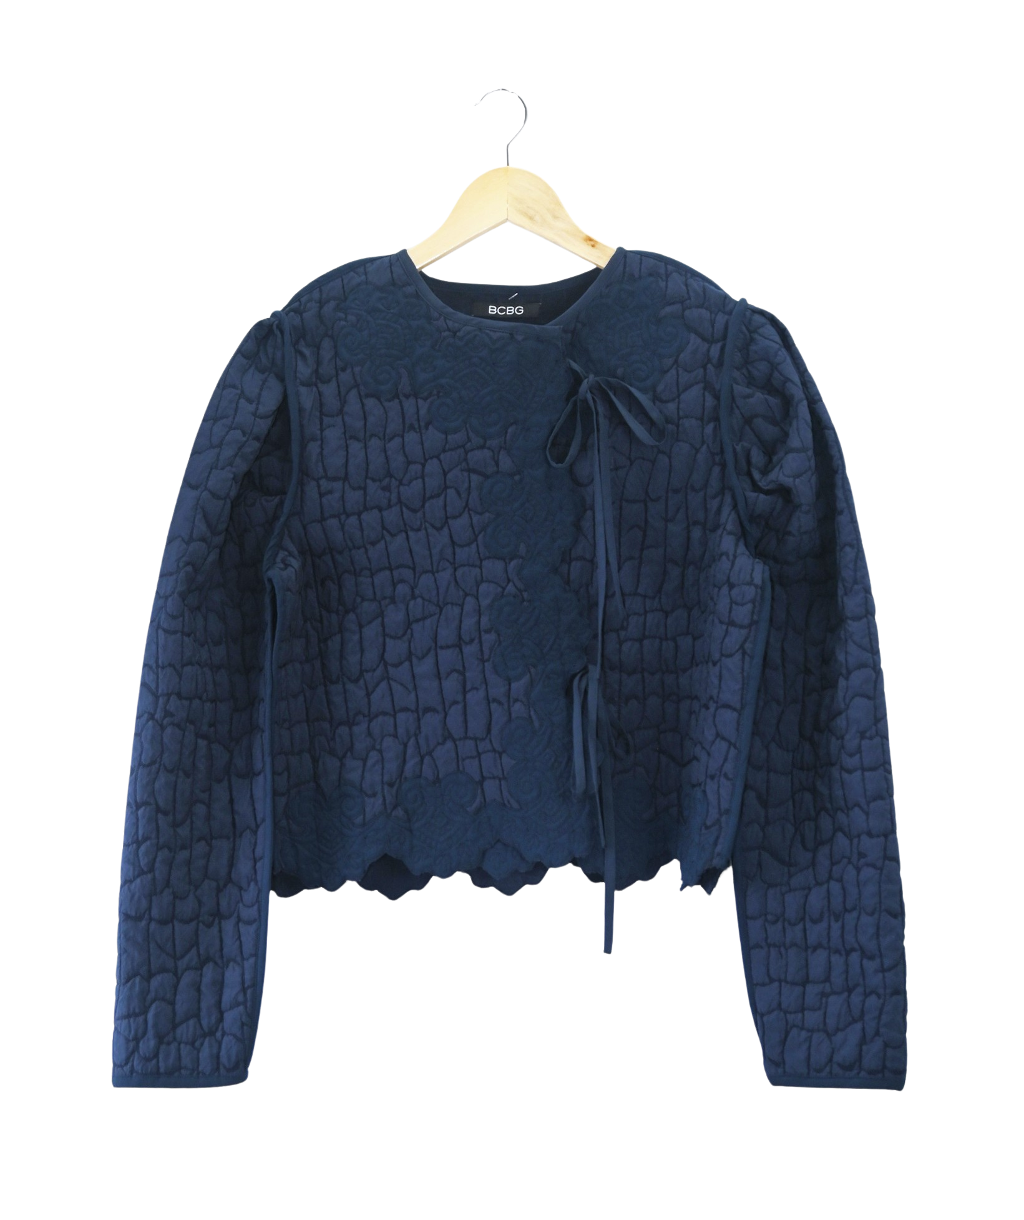
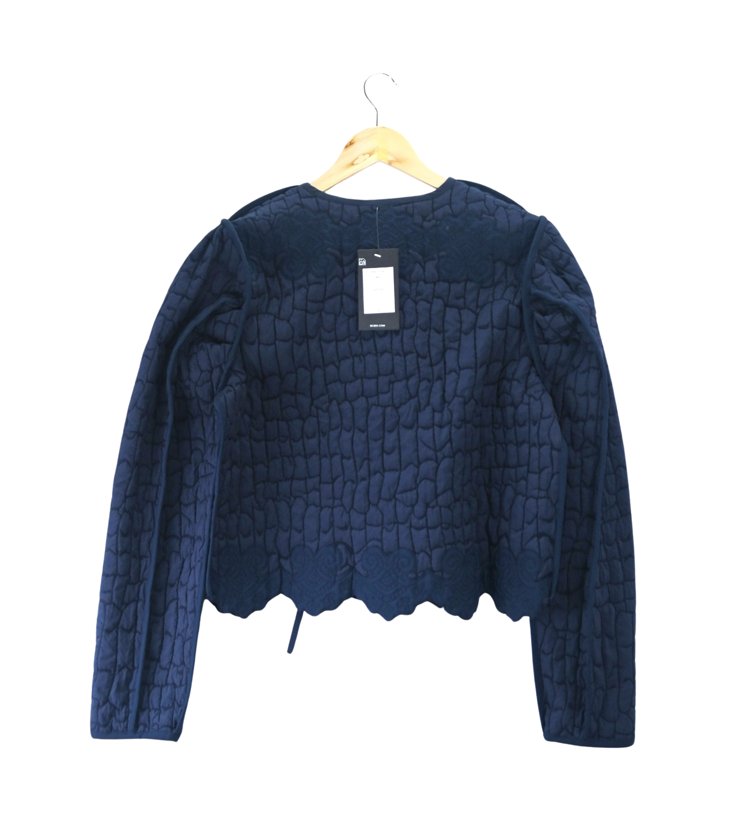
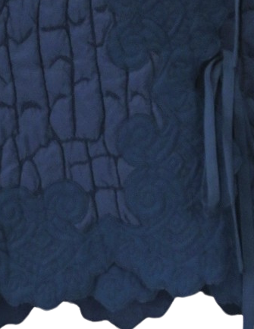
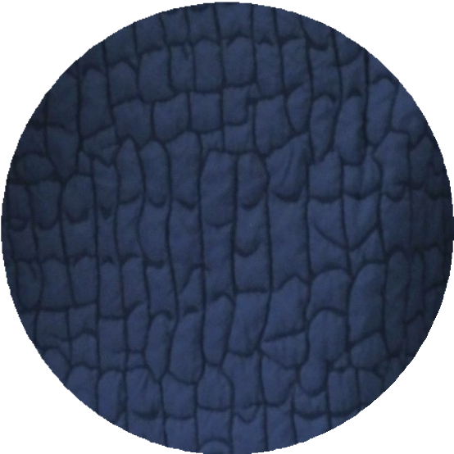
WOMEN PRODUCT
B6FC0188
100% POLY
DESIGN DETAIL
FABRIC DETAIL

